Slide 1
Playbook: Build a local Clinical Reminder Dialog Template that must be launched in two weeks to the local site < can we get an actual example project>
Description: Describes how the customer grid and value management are used in conjunction with UX tools to build and deploy a local Clinical Reminder Dialog Template.

Slide 2
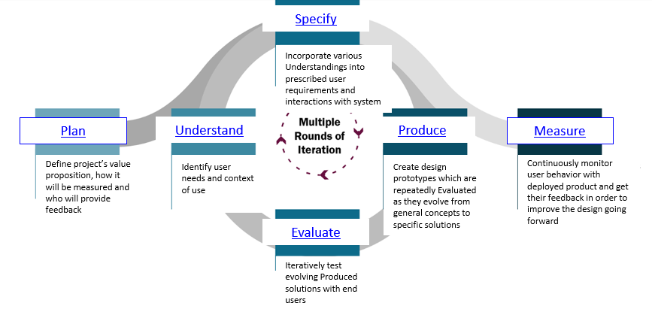
Adhering to the Process:
It is important to adhere to a process bc…
Charting the activities based on your current knowledge e.g., Clear Requirements/Ambiguous Requirements, Prioritized Users/Users = everyone, CAC’s domain knowledge/lack of knowledge, Availability of clinician SME, Time, known/unknown potential barriers
Applied Cognitive Task Analysis
Visual Modeling
Problem Statement (Writing)
Interviewing Key Stakeholder
How to ID the stakeholders
Interview-User
Observation
Visual Modeling
Literature Consultation
User Survey – Questionnaire
Heuristic Evaluation
Usability Test – Formative (time constraints may not lend for this)
Keystroke Level Modeling (KLM)

Slide 3
Plan
Identify quality objectives for usability and communicate with relevant project stakeholders. Define Process outcomes, and identify the activities and resources required for the project are identified. Define value propositions are defined.
Define the project’s value proposition, how it will be measured and who will provide feedback.
Methods:
Problem Statement (Writing)
Interviewing Key Stakeholder
Deliverables: Value Statement + Metrics, the Customer Grid, and Usability Specifications
Customer Grid – outlining the goals and measures for the template
Mapping Business Goal t the Key Quality measures
Usability Specification Table

Slide 4
Understand
Understanding the characteristics of the actual or intended user groups, including their tasks and goals, is key. In addition, the operational environment of the system, including the factors that affect the performance of the users, is described in sufficient detail to support the design activities.
Identify user needs and context of use.
Methods:
Interview-User
Observation
Deliverables:

Slide 5
Specify
Building on the value proposition from the Plan phase and user goals defined in the Understand phase, the Specify phase is where user requirements are precisely stated. These include the interaction requirements for users to achieve their intended outcomes, including the necessary information, choices, and inputs.
Incorporate various understandings into prescribed user requirements and interactions with system
Methods:
Applied Cognitive Task Analysis
Visual Modeling
Deliverables:

Slide 6
Produce
In the Produce phase, the user-system interaction is designed to address the high-level human-centered quality objectives. This phase includes the creation of an interface design solution that implements one or more user’s requirements that support tasks defined in the context of use description. The design will evolve from insights in the abstract into potential solutions, while iterating on prototypes and narrowing down the solution options.
Create design prototypes which are repeatedly evaluated as they evolve from general concepts to specific solutions
Methods:
Visual Modeling
Literature Consultation
Deliverables:

Slide 7
Evaluate
The evolving solution for user-system interaction is tested on end users during the Evaluate phase to determine if the design meets the user requirements and the initial value proposition. The team defines the relevant user profiles and tasks, as well as the context of use, for the portion of the solution that is being evaluated. The Evaluate phase is repeated on the evolving design solutions until the defined value proposition is achieved. User feedback is used to improve the solution throughout the development life cycle, particularly with respect to the results of earlier phases in the UX process.
Iteratively test evolving produced solutions with end users
Methods:
Heuristic Evaluation
Usability Test – Formative
Keystroke Level Modeling (KLM)
Deliverables:

Slide 8
Measure
When the solution meets the initial value propositions, the product is made available for use to the intended VA audience and the Measure phase continues to evaluate whether the desired value is being achieved in the users’ dynamic natural environments. As context of use and other external factors change, the design is continuously tested to determine if the value proposition is still being achieved and to inform future versions of the product.
Continuously monitor user behavior with deployed product and get their feedback in order to improve the deign going forward
Methods:
User Survey – Questionnaire
Deliverables:

